Slide 1
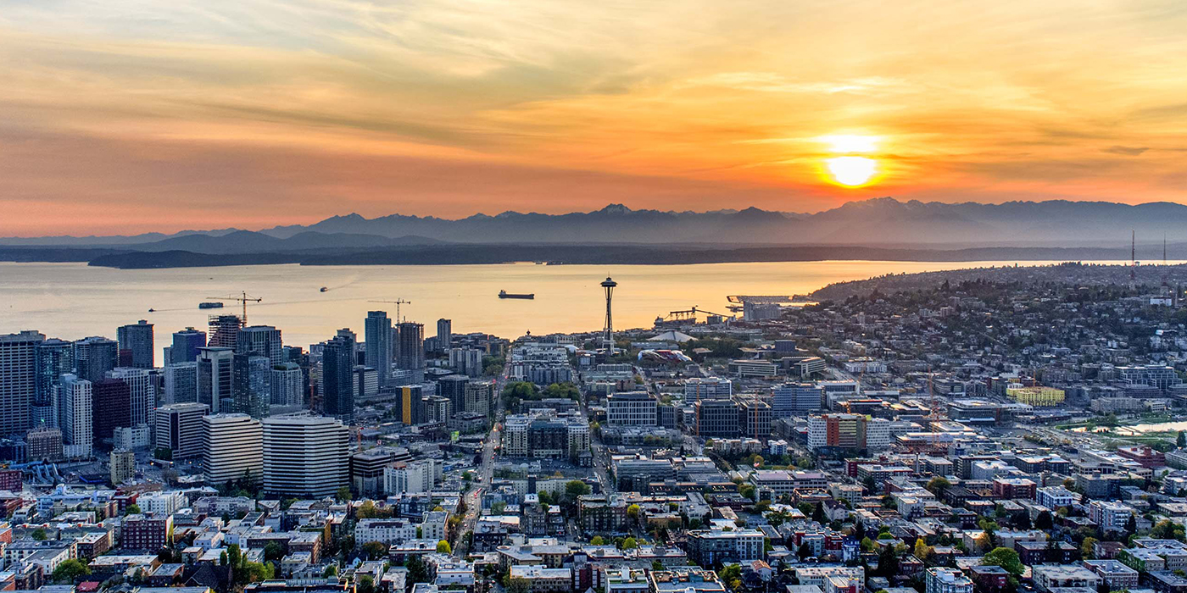
Utility Permits in the Seattle Services Portal
External Workshop
SDOT Street Use
Melody Berry, Judy Connors, Sean Bucy and William Bou
Notes:
Welcome to the SDOT Street Use Utility workshop

Slide 2
Our vision, mission, and core values
Vision: Seattle is a thriving equitable community powered by dependable transportation
Mission: to deliver a transportation system that provides safe and affordable access to places and opportunities
Committed to 6 core values:
Equity
Safety
Mobility
Sustainability
Livability
Excellence

Slide 3
Workshop overview
Accela launch overview
Launch schedule
Document requirements
How to find the status of a permit
How to respond to corrections and how to find documents
How to apply for a utility permit
Minor Utility Permit overview
Utility Major Permit overview
Process steps
Upcoming events
Application steps from the Portal
Side Sewer permit process changes
Utility permit vs. use expiration dates
Utility Major Permit thresholds
How to make changes to an issued permit
Inspections overview and how to schedule an inspection
How to get help after launch

Slide 4
Permitting system replacement goals
Improve transparency and predictability
Automate functionality to gain efficiencies
Integrate permit processes with SDCI and other departments

Slide 5
Accela launch overview
SDOT’s last implementation into Accela will be the weekend of November 7th, 2020
Traffic, Public Space Management, and Annual Vehicle permits are already in Accela
Come November, the remainder of Street Use permits will be in Accela

Slide 6
Permit types - what’s coming in November
ROWM Permits
ROW Construction (today’s Construction Use)
ROW Maintenance (new)
Heavy Crane (new)
Minor Utility
Major Permits
Utility Major
Street Improvement
Final Plat

Slide 7
Launch Schedule

Slide 8
Upcoming events
Date, Time | Topic
Sept 14th, 1-2pm | Inspection and Notifications Types Overview
Oct 19th, 3-4pm | Seattle Services Portal (SSP) Overview
Oct 26th, 2-3:30pm | Utility Permit Overview
Oct 28th, 3-4:30pm | Construction Permit Overview
Oct 30th, 11:30am-12:30pm | Street Improvement Permit Overview
Nov 3rd, 11am-12pm | Amendment Types Overview
Week of Nov 9th and 16th | General Q&A’s Sessions
One workshop per topic
Each workshop will be held virtually using Webex Events and recorded
Q&A sessions will be a 1-hour live event once or twice a week using Webex Events
Stay informed with our monthly newsletter and Accela 2 Updates website

Slide 9
Minor Utility Permit and Use Types
Hansen Use Code | Accela Use Type
51F | Side Sewer/Drainage
51G | Privately Owned Utility
51I | Exploratory Excavation
51I | Environmental Remediation
51M | Pavement Restoration
Most 51’s | Utility Infrastructure
51I | Monitoring Well
51Z | Small Wireless Facility
Minor Utility permit :
Used to permit utility installation, staging and restoration in the right-of-way
All amendments available after issuance
Record ID: SUUTIL0000001
Notes:
Most of the uses are the same as what you had in Hansen, but some have been combined or split out.
A change for Accela, use types are available on more than one record. For example: Sidewalk / driveway maintenance < 100 can also be done on the maintenance record
Big shifts:
Combined 31 and 44 – staging of things with and without wheels
44 Crane > 100 Ton on the construction record is only for operation after installation, the installation requires a heavy crane permit
Combined 50 and 50A – can take care differences through the mobility impacts settings
Exploratory excavation added to construction so customers don't always have to get a separate (utility) permit for that - it is also under utility
Miscellaneous is used for work in unimproved ROW, or when something new comes up that is not covered under an existing use type
Note: Sq ft = 100 is included in the > 100 sq ft use
[MA] Applicants (external customers) will not see the Accela Use Code value in the Seattle Services Portal, they will only see/know the Use Type name.

Slide 10

Utility Major Permit Thresholds
If your projects meets any of the below criteria, it will require a Utility Major Permit:
Any project that contains complex technical issues (e.g. deep excavations) that may have an impact to existing city assets and/or infrastructure
Installation of gas mainlines greater than 2-inches in diameter
Installation of a utility line longer than 100 linear feet on non-arterial and arterial streets including alleys
Exception: Installation of a utility line longer than 300 linear feet on a non-arterial street or alley in a single family or low-rise zone
Removal of an underground storage tank
Environment remediation or contaminated soil cleanup
Work that triggers ADA curb ramps installation due to utility work (e.g. utility and telecom pole removal/installation at intersections)
Area based work that exceeds a one-block radius
Directional or horizontal boring method of installation
*Street Use may require an UMP beyond the thresholds outlined above in consideration of complexity of the work including proximity to existing infrastructure or assets.
Note: SPU Sewer, Water and Storm Main extensions will now be under a SIP using the Public Main use type.

Slide 11
Utility Major Permit and Use Types
Hansen Use Code | Accela Use Type
51/51A | Major Utility Infrastructure
51Z | Small Wireless Facility
Utility Major Permit :
Used to permit utility installation, staging and restoration in the right-of-way with larger impacts than the Minor Utility permit
All amendments available after issuance
Record ID: SUUMP0000001

Slide 12
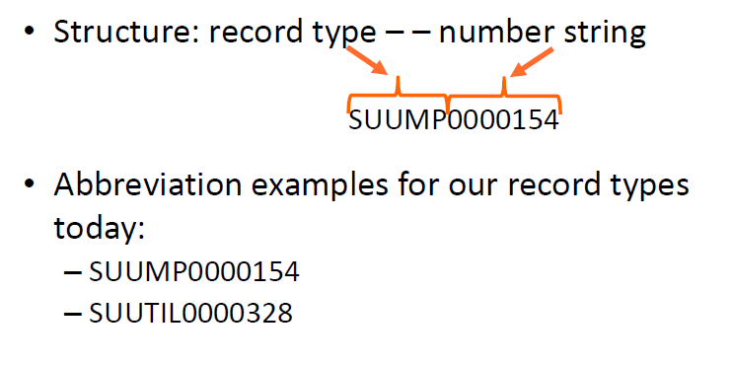
Utility Accela permit numbers decoded
Notes:
Here are the high level steps to applying for a Minor Utility permit and Utility Major permit.

Slide 13
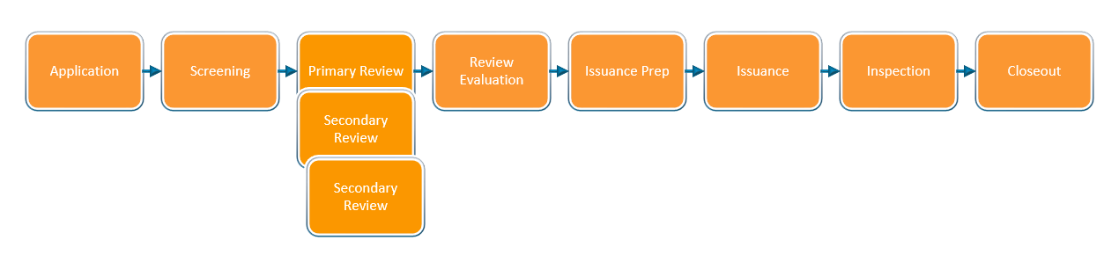
Permit process steps
Review Process

Slide 14
Minor Utility Document Requirements
Document Type | Document Description | When it’s Required Along the Permit Path
Right of Way Impact Plan | Row-of-way closures with details per CAM 2116 | Application – cannot submit without uploading this document
Site Plan | Utility location details per CAM 2116 | Application – cannot submit without uploading this document (not required for the Side Sewer/Drainage use type)
Letter of Authorization | Required if Applicant or FRP contact is different from the Owner contact | Application – cannot submit without uploading this document
Traffic Control Plan | Temporary traffic control plan per CAM 2111 and the City of Seattle Traffic Control Manual for In-Street Work | Either at Application if the street category is manually set to Arterial or at Screening when the reviewer verifies work is on an arterial or any street in a Hub
Temporary No Parking Confirmation (Paid Parking Permit) | If paid parking is impacted by the project, some sort of proof that a parking permit has been submitted | Review Evaluation
Other documents | Based on project location and impact: Historic District CoA, Holiday Moratorium Waiver per CAM 2107, Pavement Moratorium etc. | Review Evaluation
Corrections Response | Street Use Comments Sheet with responses | Screening – cannot submit Corrections Submitted if this is required
Notes:
TNP Confirmation can be one of the following:
A copy of the Application Received email
A screen image of the application record details page
A copy of the permit
A copy of a signed billing agreement
A copy of an email from Traffic staff indicating no reservation needed

Slide 15
Utility Major Permit Document Requirements
Document Type | Document Description | When it’s Required Along the Permit Path
Utility and Restoration Plan | Utility and restoration detail plan per the Utility Work in the Right of Way webpage | Application – cannot submit without uploading this document
Letter of Authorization | Required if Applicant or FRP contact is different from the Owner contact | Application – cannot submit without uploading this document
Traffic Control Plan | Temporary traffic control plan per CAM 2111 and the City of Seattle Traffic Control Manual for In-Street Work | Either at Application if the street category is manually set to Arterial or at Screening when the reviewer verifies work is on an arterial or any street in a Hub
Right of Way Impact Plan | Row-of-way closures with details per CAM 2116 | Screening after the first review cycle
Phase Schedule Manager | Schedule per street frontage per the Utility Work in the Right of Way webpage | Screening after the first review cycle
Temporary No Parking Confirmation (Paid Parking Permit) | If paid parking is impacted by the project, some sort of proof that a parking permit has been submitted | Review Evaluation
Other documents | Based on project location and impact: Historic District CoA, Holiday Moratorium Waiver per CAM 2107, Pavement Moratorium etc. | Review Evaluation
Corrections Response | Street Use Comments Sheet with responses | Screening – cannot submit Corrections Submitted if this is required
Notes:
TNP Confirmation can be one of the following:
A copy of the Application Received email
A screen image of the application record details page
A copy of the permit
A copy of a signed billing agreement
A copy of an email from Traffic staff indicating no reservation needed

Slide 16


Utility use vs. permit expiration dates
The utility permit open period has been extended from 90-days to 6-months
The 6-month period begins with the earliest use start date for the initial issuance and initial 6-month period
If the duration of the work extends past the issued duration, you will need to apply for an Extension Amendment to extend the use period
In Hub areas, you will need to coordinate dates outside the issued dates and extension periods before proceeding with work (email SDOTConstructionHub@seattle.gov)
If the extended use period goes beyond the previous 6-months, a new 6-months period will start based on the previous permit expiration date
If there are multiple uses on a utility permit and one use extends past the earliest use start date + 6-months period, the permit expiration is set to the latest use expiration date

Slide 17
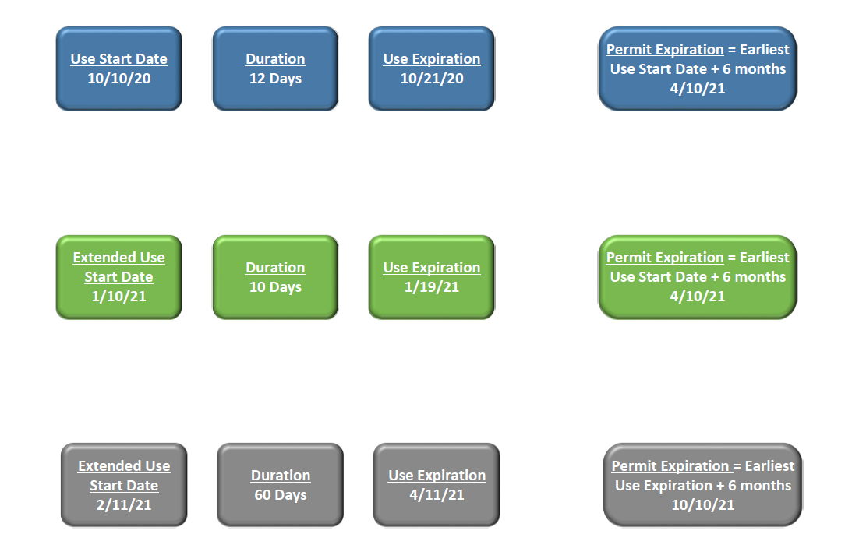
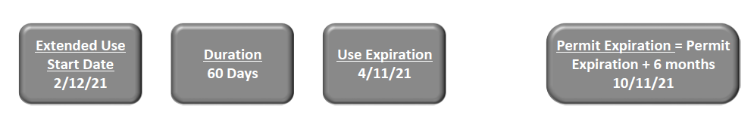
Utility use vs. permit expiration dates
Pay attention to the use expiration date in relation to the permit expiration date
Initial Issuance
Extension within original 6-months
Extension that extends beyond the original 6-months

Slide 18
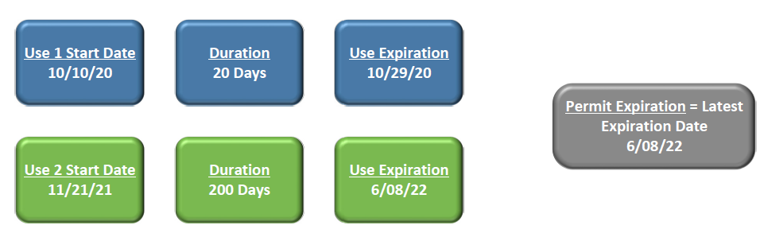
Utility use vs. permit expiration dates
If there are multiple uses on a utility permit and one use extends past the earliest use start date + 6-months period, the permit expiration is set to the latest use expiration date

Slide 19
Application steps from the Portal
Select Permit Type
Enter
Project Address
Add Contacts
Enter Project & Location Description
Enter Related Information
Add Use Details
Upload Required Docs
Review Application Information
Submit & Thank You

Slide 20
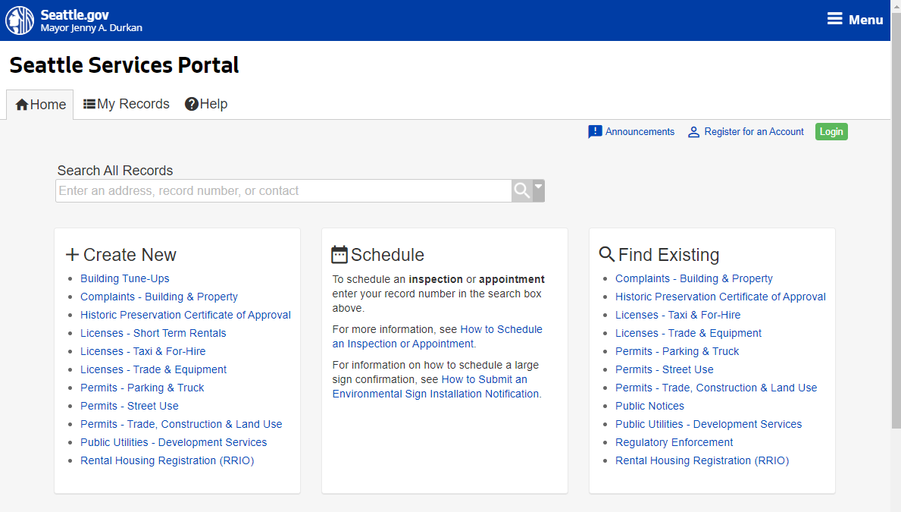
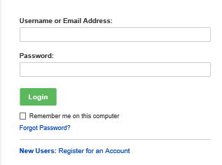
How to apply for a utility permit
How to apply for a utility permit
Go to the Seattle Services Portal
Click on the Login button
Enter your username and password and click on the Login button
Note: If you don’t have an account, see our Seattle Services Portal Overview recording and PowerPoint presentation.
2
3

Slide 21


To login or not to login
What you can do if you login if you are a permit contact or delegate:
Apply for applications
Withdraw an application
View and upload documents
Respond to Corrections
Make changes to an issued permit
Assign delegates
What you can do if you are not logged in and not a permit contact or delegate:
Search for permits
View permit information except documents
Make payments
Schedule an inspection

Slide 22
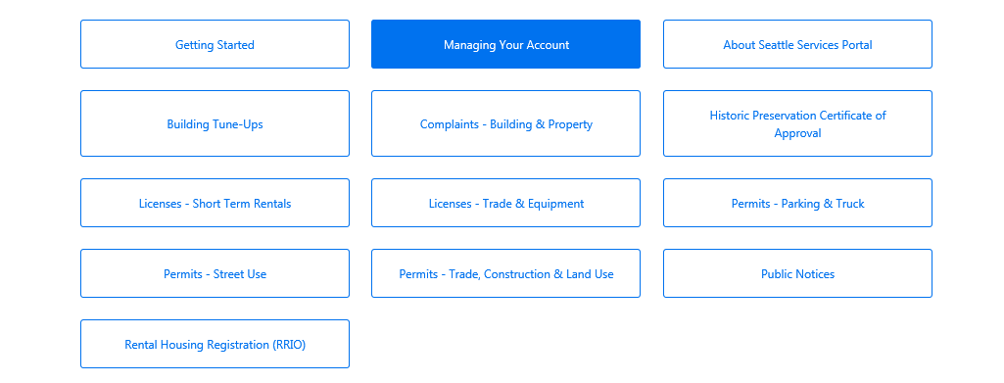
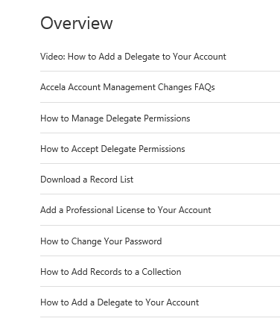

How to add and manage contact delegates
3
For more information about delegates:
Go to the Seattle Services Portal
Click on the Help link
Click on Managing Your Account
Read and/or view the highlighted articles and video on delegates
4

Slide 23
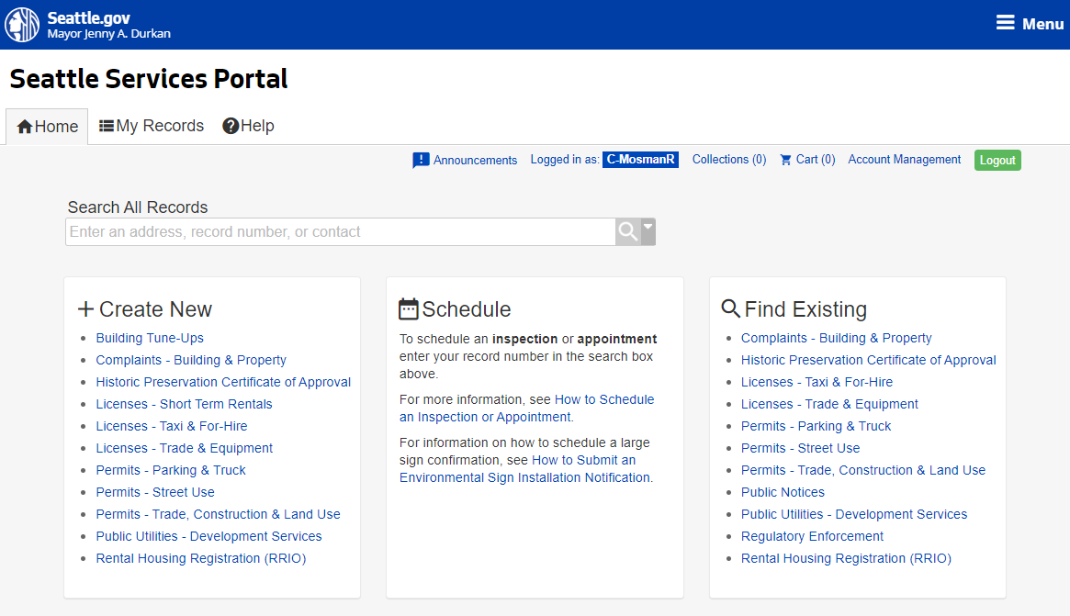
How to apply for a utility permit
How to apply for a utility permit
Under the Create New section, click on the Permits – Street Use link
4

Slide 24
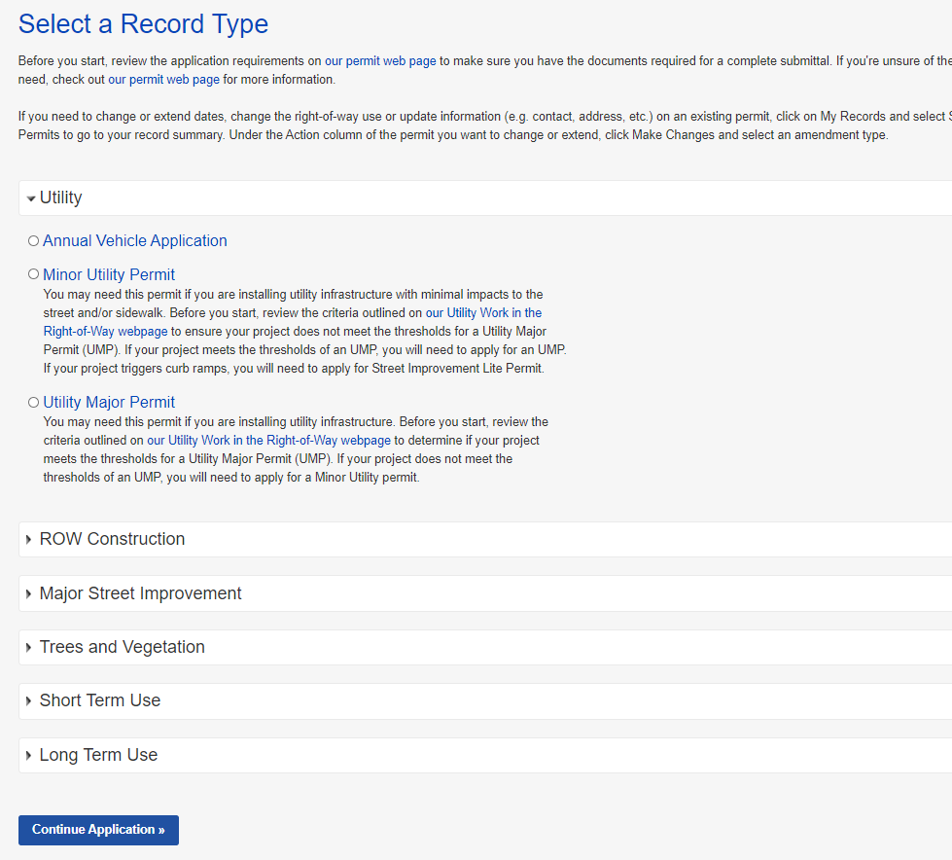
How to apply for a utility permit
5
How to apply for a utility permit
Expand the Utility section
Determine the appropriate permit type:
Click on the Utility Work in the Right-of Way webpage link
Review the permit criteria to determine if you need a Minor Utility or Utility Major permit
Once the permit type is determined, click on the circle next to that permit type and click on the Continue Application button
a
Note: This line is incorrect. If utility work triggers curb ramps per the ROWORR, this would require an UMP, not SIP Lite.
7

Slide 25
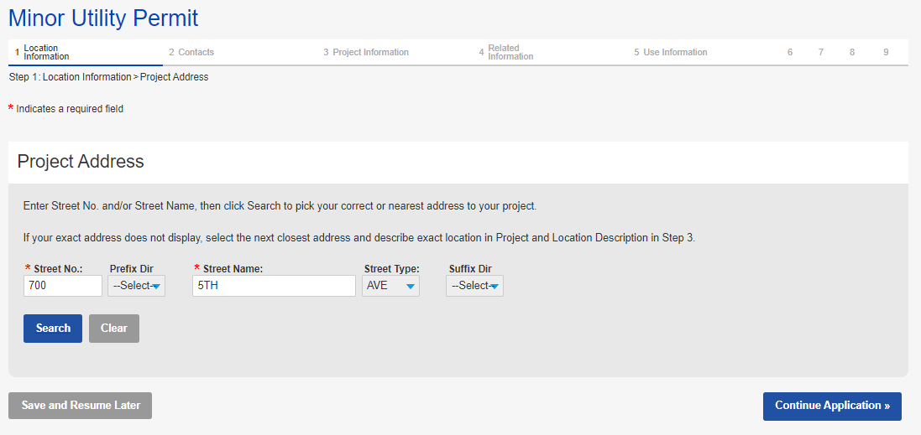

Application page overview
Application steps
Indicates what step you are on and what steps you have already completed
Required field
Moves you to the
next step
You can save at any step and resume later if needed

Slide 26
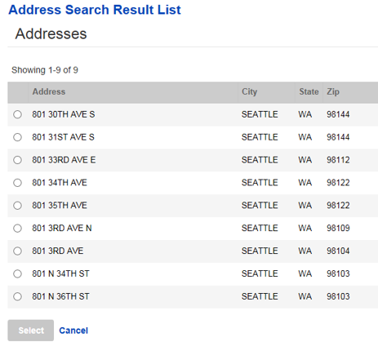


How to apply for a utility permit
How to apply for a utility permit
To enter the Project Address:
Enter information in the required fields and click the Search button
If there is not an exact match: from the pop-up window, select the correct address and click the Select button
Click on the Continue Application button
a
c
If the street name is a number, only enter the number
b
9

Slide 27
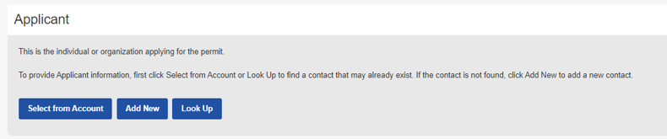
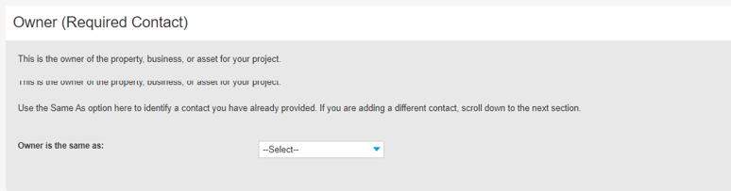
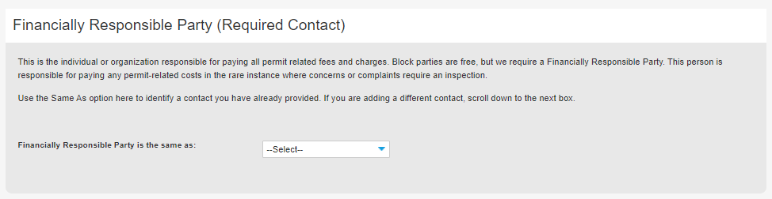
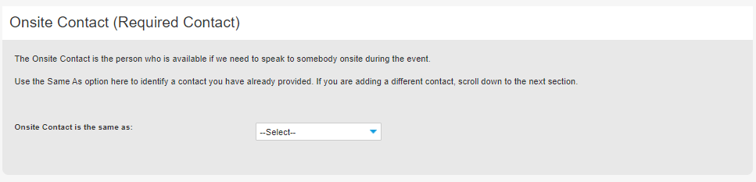
Contacts overview
Select from Account: Auto-populates the contact associated with the login account
Add New: You will need to create a new contact (do this cautiously)
Look Up: Search for an existing contact
On every Street Use permit, there are 4 required contacts:
Applicant: The individual applying for the permit
Owner: Property, business or asset/infrastructure owner (note: owner can be transferred to a different entity civilly)
FRP: The organization responsible for paying all related fees and charges
Onsite Contact: The individual who Street Use calls to respond to events (e.g. storm response)
After one contact is added, you can also use the Same As drop down menu to select a previously added contact

Slide 28
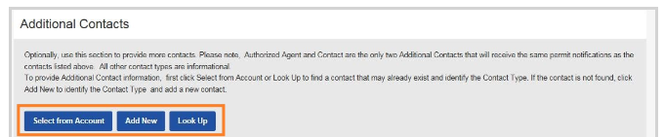
Contacts overview
You can also add the following additional contacts as needed:
Arborist
Architect
Authorized Agent
Contact
Contractor
Engineer
Vending Operator
Select from Account: Auto-populates the contact associated with the login account
Add New: You will need to create a new contact (do this cautiously)
Look Up: Search for an existing contact
Authorized Agent and Contact receive all permit correspondence

Slide 29
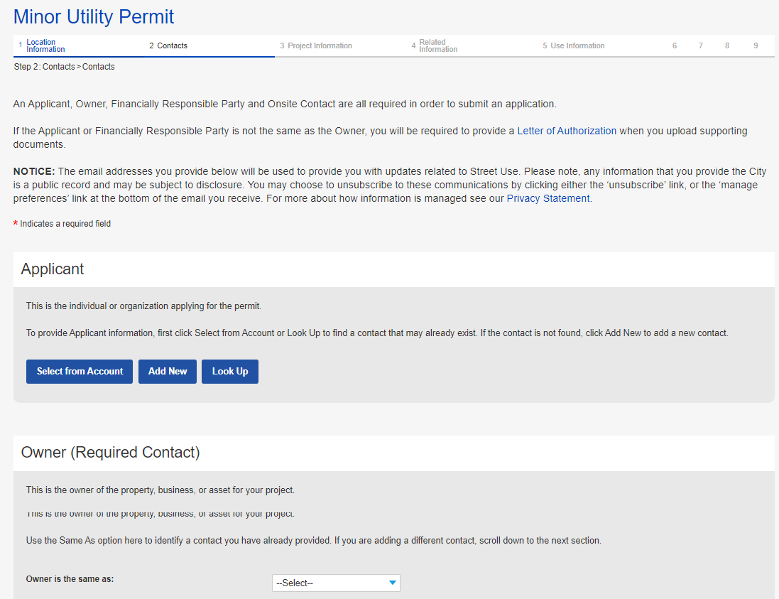
How to apply for a utility permit
How to apply for a utility permit
Enter all required contacts:
Applicant
Owner
Financially Responsible Party (FRP)
Onsite
10
Notes:
Optionally, if there is an exact match, there will not be

Slide 30
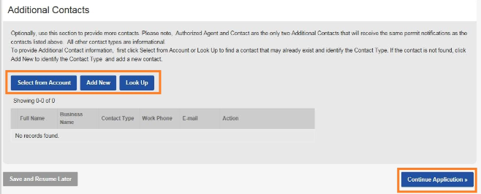
How to apply for a utility permit
How to apply for a utility permit
Optionally, enter additional contacts
Click on the Continue Application button
11
12
Notes:
Optionally, if there is an exact match, there will not be

Slide 31
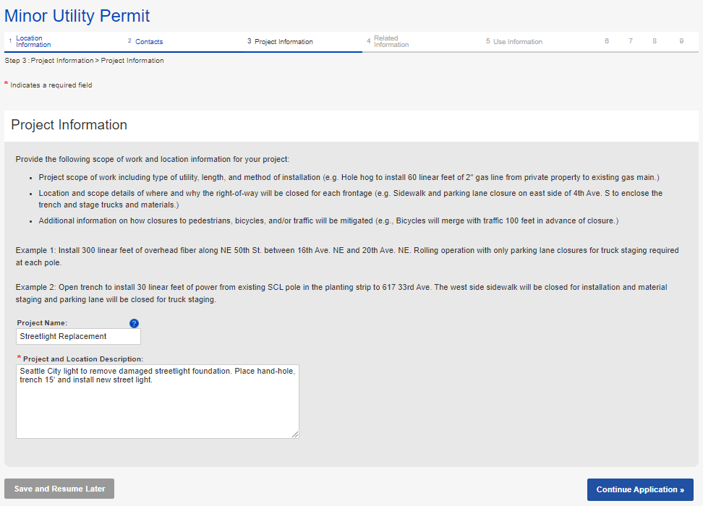
How to apply for a utility permit
The top section describes what we want in a project and location description with some examples
How to apply for a utility permit
Enter Project Name and Project and Location Description
Click on the Continue Application button
13
14
Notes:
Optionally, if there is an exact match, there will not be

Slide 32
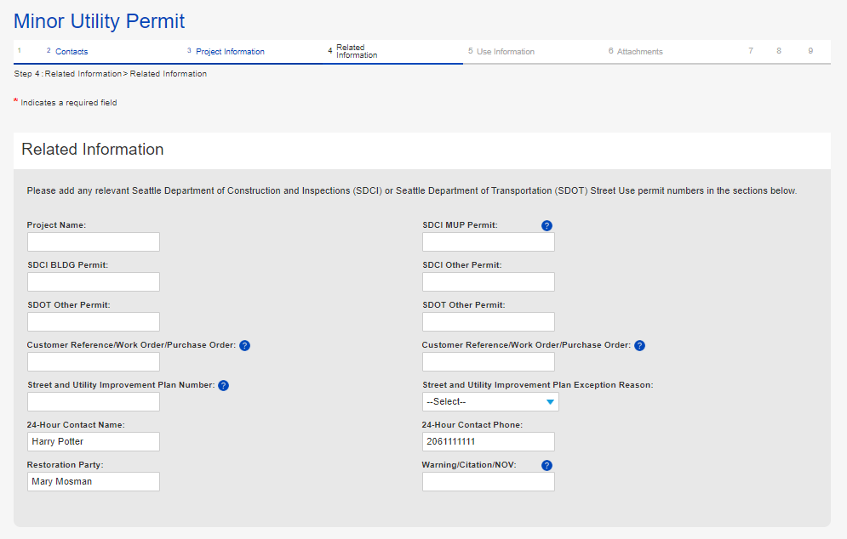
How to apply for a utility permit
How to apply for a utility permit
Enter the following Related Information:
Related permit numbers
Related project information
24-Hour contact information (defaults to Applicant)
Restoration Party
(defaults to Owner)
Enforcement number
a
Prints on the invoice
b
c
d
e
Notes:
Optionally, if there is an exact match, there will not be

Slide 33
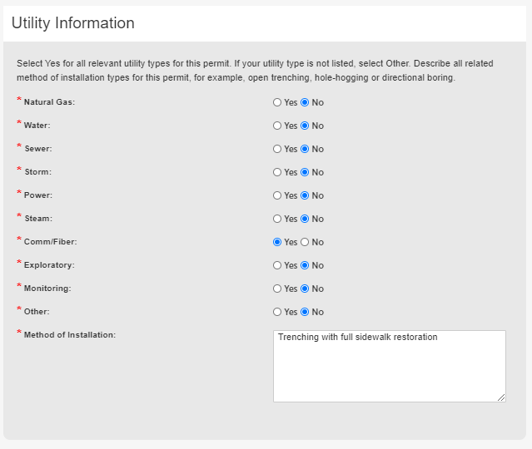
How to apply for a utility permit
How to apply for a utility permit
Enter the following Related Information:
Related type of utility
Tip: All options default to ‘No.’ At least one type of utility needs to be set to ‘Yes.’ You can select ‘Yes’ for more than one utility type. If you select Other, a free text field will pop-up and will need to be populated with text.
Method of Installation (free text field)
f
g
Notes:
Optionally, if there is an exact match, there will not be

Slide 34
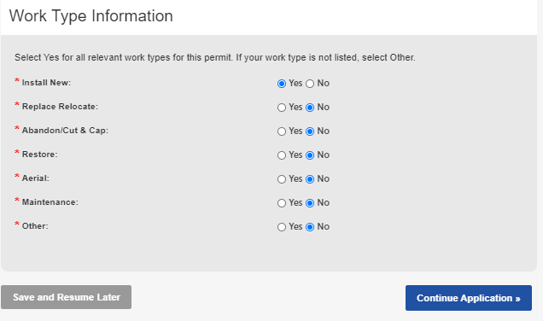
How to apply for a utility permit
How to apply for a utility permit
Enter the following Related Information:
Related work type – what are you doing with the utility
Tip: All options default to ‘No.’ At least one work type needs to be set to ‘Yes.’ You can select ‘Yes’ for more than one work type. If you select Other, a free text field will pop-up and will need to be populated with text.
Click on the Continue Application button
h
16
Notes:
Optionally, if there is an exact match, there will not be

Slide 35
Use fee methodology changes
Use Fee Rate Changes Summary
Mobility/Safety Factors
Facility and Use | Current (2019) | Nov 9th, 2020 | Delta
Transit Blocked | $0.015 | $0.20 | +$0.185
Bike Blocked | $0.015 | $0.20 | +$0.185
Pedestrian Blocked | $0.015 | $0.20 | +$0.185
Pedestrian Impacted | $0.010 | $0.10 | +$0.090
Density Factors
Facility and Use | Current (2019) | Nov 9th, 2020 | Delta
Urban Center | $1.00 | $1.10 | +$0.10
Urban Village | $0.70 | $0.70 | -
Neither | $0.40 | $0.20 | -$0.20
Increased factors for blocked transit, bike, and pedestrian facilities
Increased factor for working in an Urban Center
Reduced fees for work outside urban zones and on non-arterial streets
35
Notes:
2005-2018 model
Fees charged in 10-day increments
Cost did not differentiate by location or impact to the traveling public
Methodology did not change over a long period of time to ensure cost recovery or evolving policy and modal priorities
2019 model
Pros:
Charged by day instead of 10-day increment
Targeted department priorities by adding additional factors to work in Urban Centers and Villages and to work that closed modal priority segments (transit, bike and sidewalk)
Cons:
Added level of complexity to estimation and data entry
Increased rates for projects on non-arterial streets outside Urban zones
Did not add enough impact to transit, bike and sidewalks to reduce duration and level of impact

Slide 36
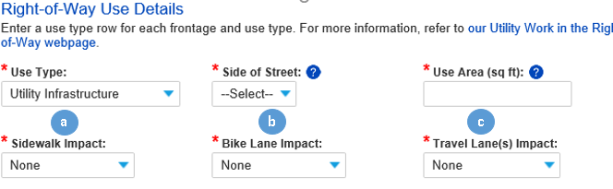
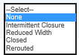
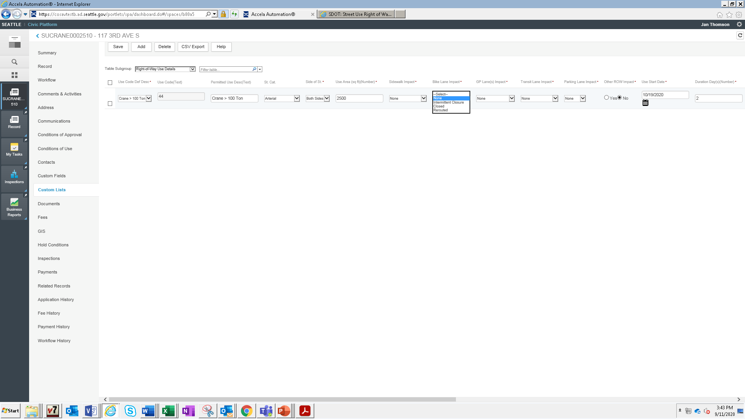


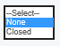
Use fee methodology changes
The calculation has been revised to allow the following impacts to be summed at the frontage level:
Sidewalk Impact = Concrete sidewalk or asphalt pathway
Bike Lane Impact = 24/7 dedicated bike lane
Travel Lanes Impact = General purpose travel lanes
Transit Lane Impact = 24 hour dedicated bus or other transit lanes
Parking Lane Impact
Other ROW = Gravel shoulder, planting strip etc.
Impact Option Definitions:
Intermittent closure = Short-term (less than 5 mins) closures 3 times or less an hour to stop the traveling public using a flagger or UPO
Reduced width = For s/w: partial sidewalk closure with at least a 4’ pedestrian pathway per ADA; For GP lane: reduced width travel lane while maintaining vehicular traffic
Rerouted = The traveling public has been routed to a different part of the street scape
Closed = Completely closed to the traveling public
Some Lanes Closed = 1 or more travel lanes closed
All Lanes Closed = All travel lanes closed; traffic must be rerouted
d
e
f
Notes:
For presentation only classes

Slide 37

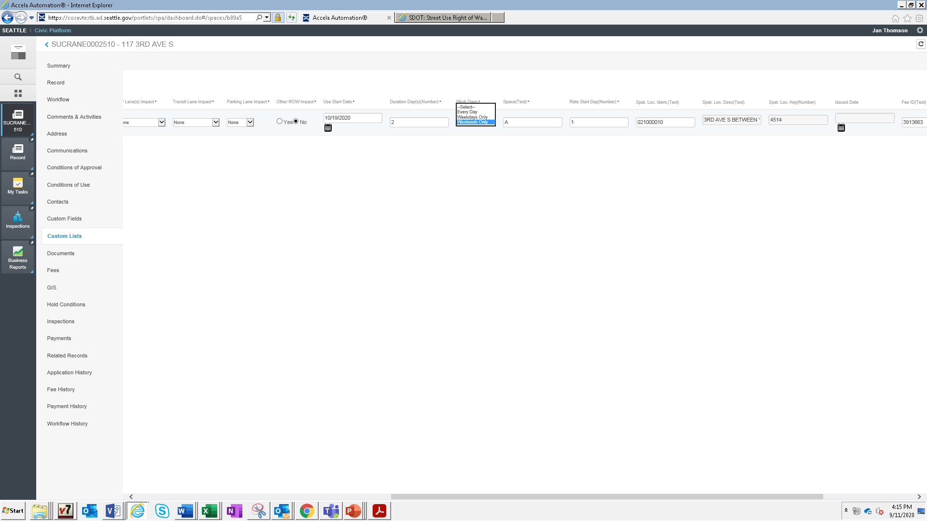
Use fee methodology changes
New section to select when work will be occurring to help manage long or intermittent durations:
Work Days:
Every Day = weekdays and weekends
Weekdays Only = Monday - Friday
Weekends Only = Saturday and Sunday
a
Notes:
For presentation only classes

Slide 38
Use fee methodology changes
Use Fee Rate Changes Summary
Mobility/Safety Factors
Facility and Use | Current (2019) | Nov 9th, 2020 | Delta
Transit Blocked | $0.015 | $0.20 | +$0.185
Bike Blocked | $0.015 | $0.20 | +$0.185
Pedestrian Blocked | $0.015 | $0.20 | +$0.185
Pedestrian Impacted | $0.010 | $0.10 | +$0.090
Density Factors
Facility and Use | Current (2019) | Nov 9th, 2020 | Delta
Urban Center | $1.00 | $1.10 | +$0.10
Urban Village | $0.70 | $0.70 | -
Neither | $0.40 | $0.20 | -$0.20
Some impact types (transit, bike and pedestrian) have a Mobility and Safety Factor added at the use level if that impact type is blocked or impacted:
Blocked = Closed
Impacted = Reduced Width
Although the new equation allows us to sum all closures at the frontage level, you will want to separate out impacts with factors from impacts without factors
1

Slide 39
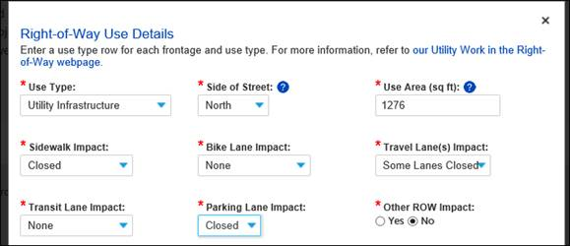
Use fee methodology changes
Example 1: Minor Utility project on a non-arterial for 10 days
Since non-arterial streets do not incur use fees for the first 30 days, you can sum up all closures under one line

Slide 40
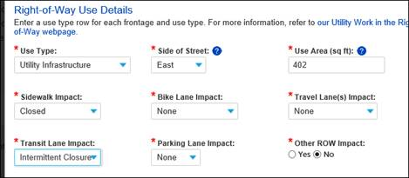
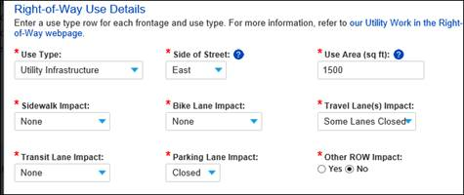
Use fee methodology changes
Example 2: Minor Utility project on an arterial for 10 days
Since arterial streets incur use fees on day one, separate lines with:
One line that has impacts with Mobility and Safety Factors (sidewalk, bike lane and transit lane)
Tip: The combination of Sidewalk + Reduced Width has a lower factor, that combination should always be a separate use row.
One line that has impacts with no Mobility and Safety Factors (GP lanes, parking lane and other ROW impact)
a
b

Slide 41
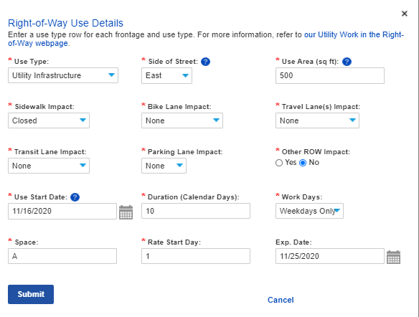
How to apply for a utility permit
How to apply for a utility permit
Enter at least one-use type row:
From the Use Type drop-down menu, select the appropriate use type
Enter Side of Street
Tip: For road closures, select Both Sides.
Enter Use Area
Note what mobility type is impacted
Enter Use Start Date
Enter Duration
From the Work Days drop-down menu, indicate when work will occur
Click on the Submit button
a
b
c
d
e
f
g
18
Notes:
Optionally, if there is an exact match, there will not be

Slide 42
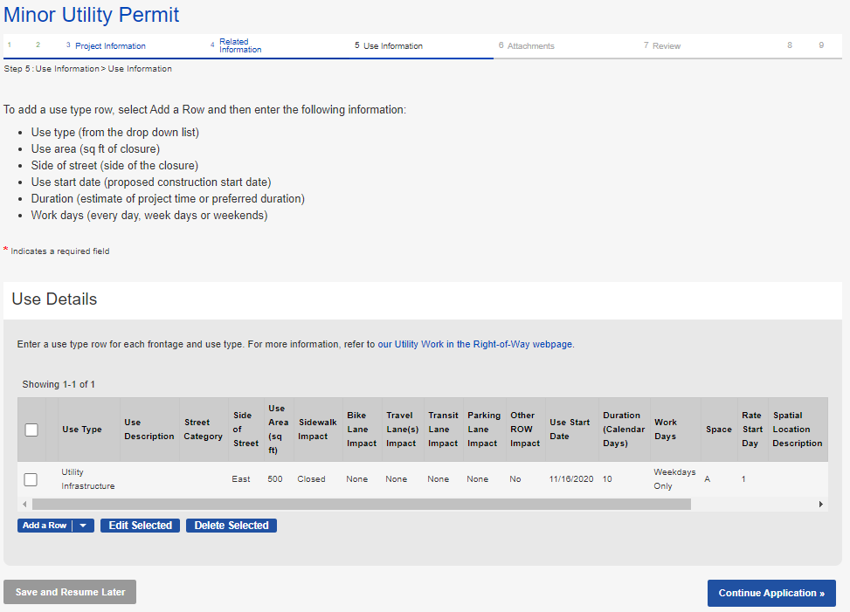
How to apply for a utility permit
How to apply for a utility permit
To add another use type row, click the Add a Row button
Once all use types rows are entered, click on the Continue Application button
19
20
Notes:
Optionally, if there is an exact match, there will not be

Slide 43
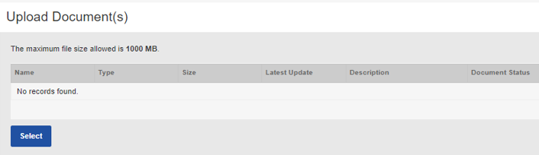
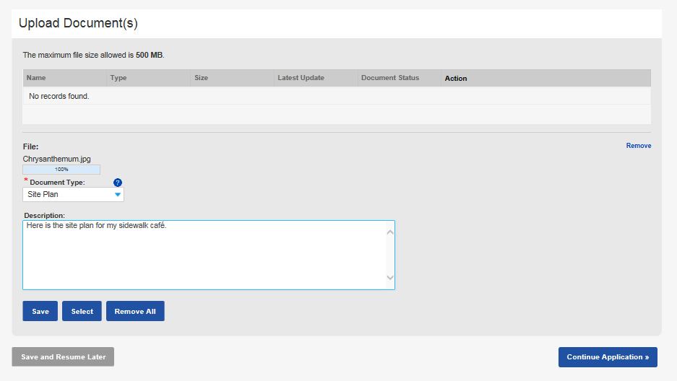
How to apply for a utility permit
a
How to apply for a utility permit
Upload all required documents:
Click the Select button
Choose the desired document from your computer
From the Document Type drop-down menu, select the type of document you are uploading
Tip: For us to perform efficient plan review, only upload PDF documents.
Add a description (optional)
Click the Save button
To upload another document, click the Select button
c
d
e
f
Notes:
Optionally, if there is an exact match, there will not be

Slide 44
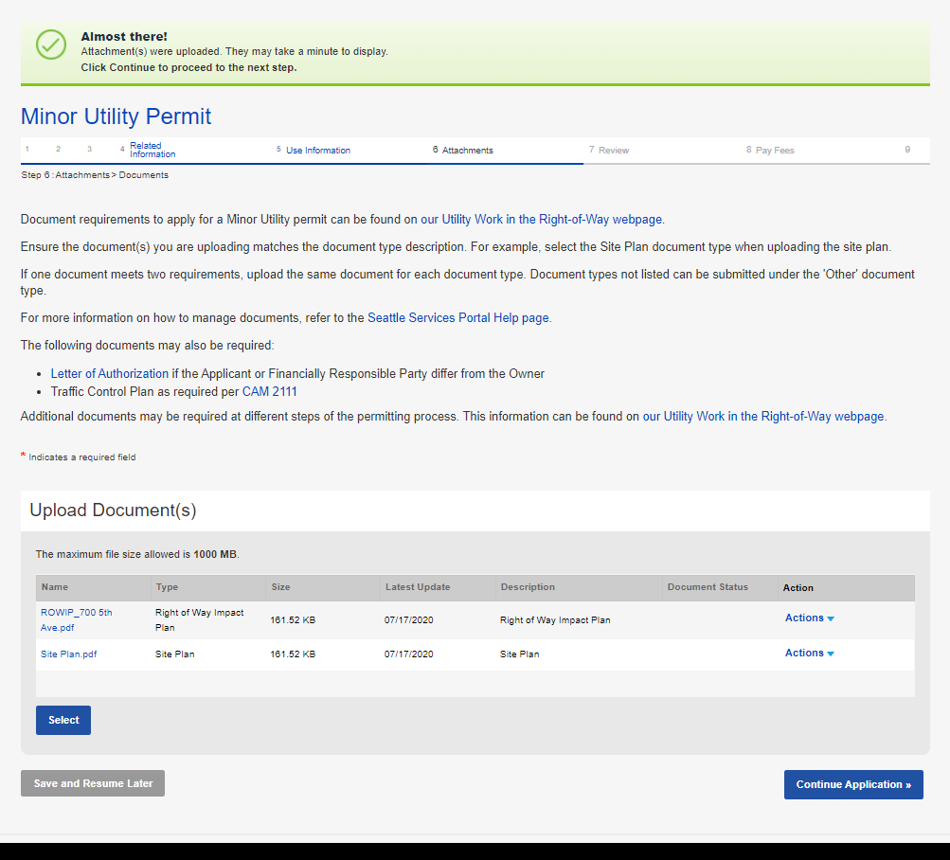
How to apply for a utility permit
If you click Continue Application before uploading all required document, this banner will turn red and indicate what documents are missing. It will turn green when all required documents have been uploaded.
How to apply for a utility permit
Once all required and desired documents are uploaded, click the Continue Application button
22
Notes:
Optionally, if there is an exact match, there will not be

Slide 45
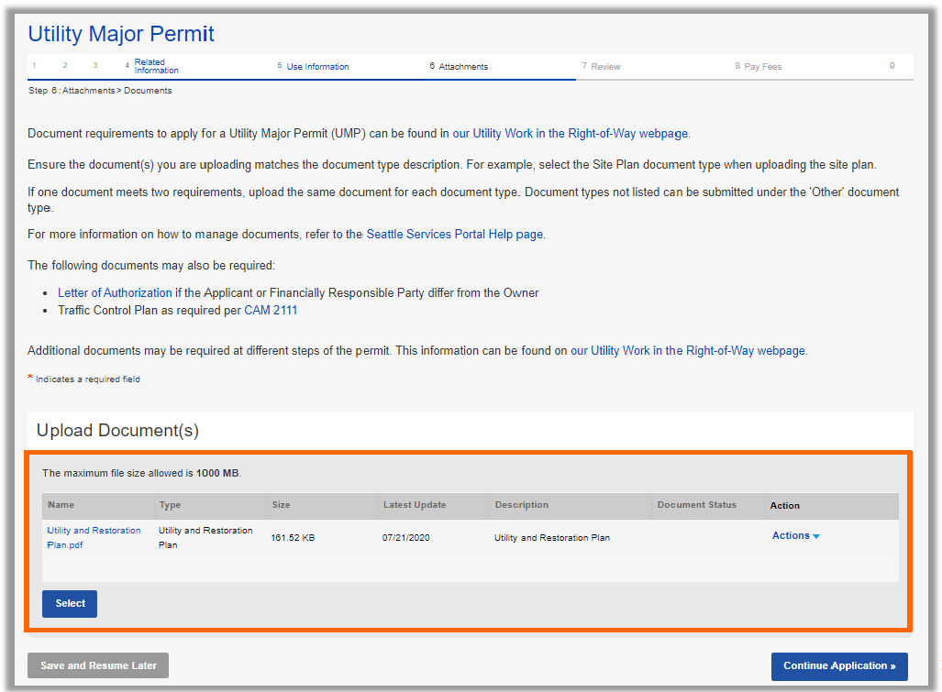
How to apply for a utility permit
For the Utility Major Permit application, the required document will be the Utility and Restoration Plan at application

Slide 46
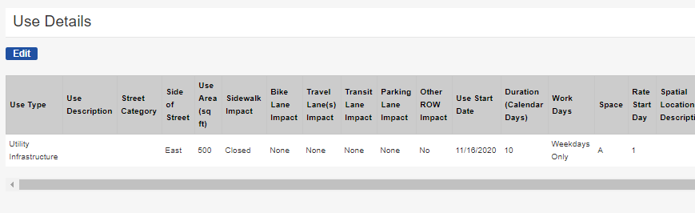
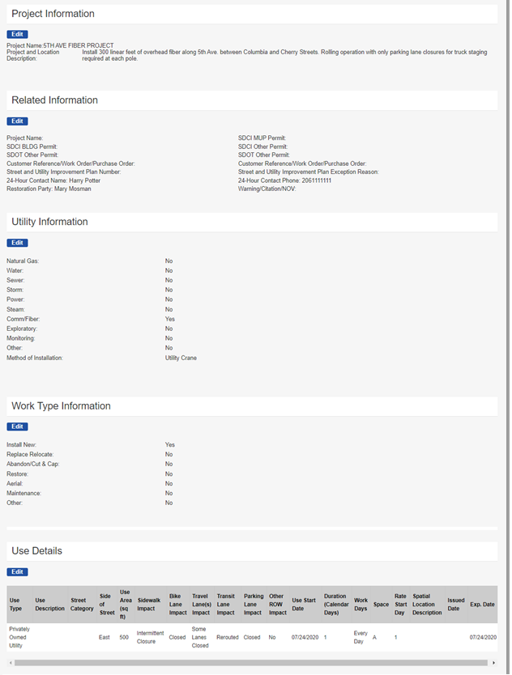
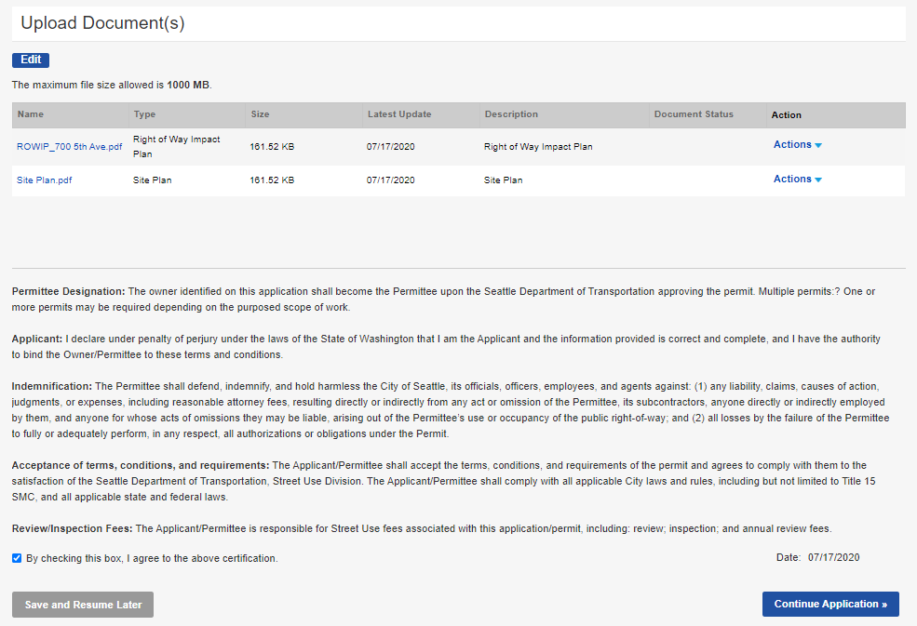
How to apply for a utility permit
How to apply for a utility permit
Go through all application pages to ensure information is accurate (use the Edit button to make changes)
Once the application is ready to submit:
Check the terms of agreement box
Click the Continue Application button
a
b
46
Notes:
Optionally, if there is an exact match, there will not be

Slide 47
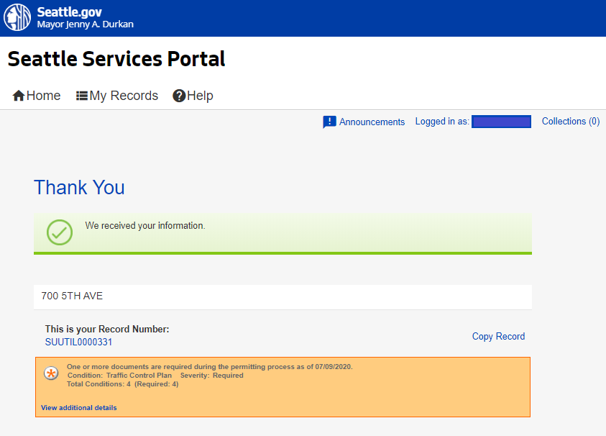
How to apply for a utility permit
How to apply for a utility permit
Once the application is submitted, you will receive a Thank You confirmation with your Record Number noted
You can open the permit by clicking on the blue hyperlink permit number
If there are additional documents required later in the permit process, it will show in this box.
25
47
Notes:
Same process for UMPs except document requirements will be different.

Slide 48
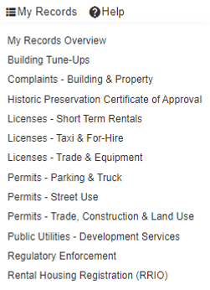
How to find the status of your permit
How to find the status of your permit
You can find your permit in two ways:
Searching for the individual record under Find Existing in Permits – Street Use
Find the permit under the My Records page, either in My Records Overview or in Permit – Street Use
b
a
Notes:
When the task status is changed to Additional Information Required, the applicant receives an email saying that a new document is needed.
When the applicant then goes to his/her SSP account, this is what he/she will see…Additional Info Requested.

Slide 49
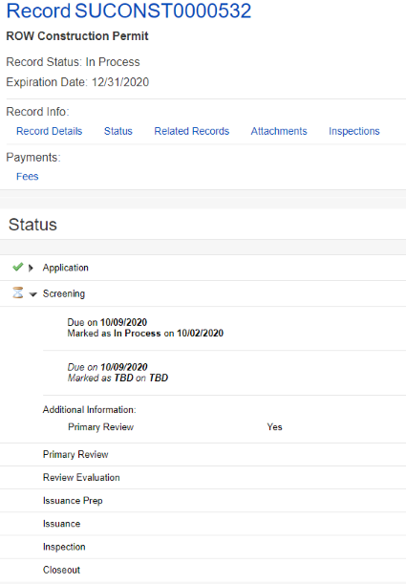
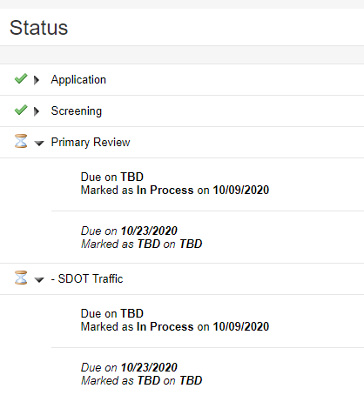
How to find the status of your permit
How to find the status of your permit
From the individual permit:
Click on the Status tab
The Application task is shown as complete with a green check
The Screening task is shown as In Process with an hourglass
When you expand the Screening task, you can see the due date, history of the task processing and the active Primary Review task
The next task is Primary Review
If there are required secondary reviewers (e.g. SDOT Traffic), they will show under the Screening task with their due date and status after the Screening task is completed
a
f
b
c
d
e
Notes:
When the task status is changed to Additional Information Required, the applicant receives an email saying that a new document is needed.
When the applicant then goes to his/her SSP account, this is what he/she will see…Additional Info Requested.

Slide 50
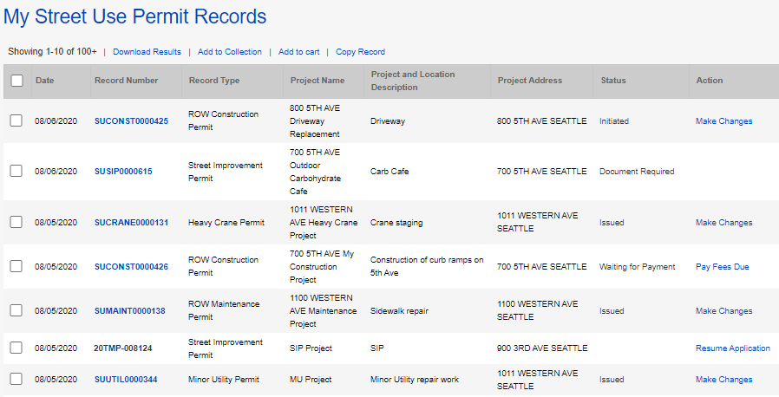

How to find the status of your permit
How to find the status of your permit
From the My Records page:
The status of the permit will show in the Status column
a
Notes:
When the task status is changed to Additional Information Required, the applicant receives an email saying that a new document is needed.
When the applicant then goes to his/her SSP account, this is what he/she will see…Additional Info Requested.

Slide 51
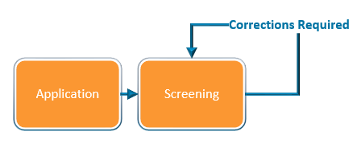
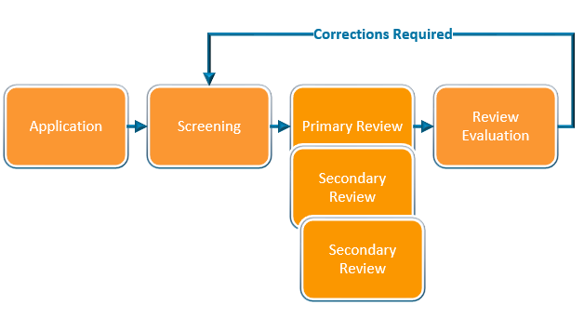
How to respond to corrections
Corrections can be required in the Screening or Review Evaluation task
Once the task is set to request corrections, the record status will change from In Process to Awaiting Corrections
Notes:
Moving on… Now, I will walk you through how to apply for a change (an amendment) to an issued permit.

Slide 52
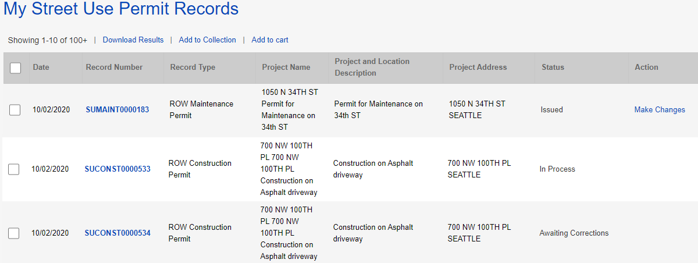
How to respond to corrections
How to respond to corrections
From the My Records page, the Status of the permit will show as Awaiting Corrections
Click on the blue hyperlink permit number
1
2
Notes:
Moving on… Now, I will walk you through how to apply for a change (an amendment) to an issued permit.

Slide 53


How to respond to corrections
3
How to respond to corrections
Click on the Status tab
The red banner will indicate what document is required
Click on the View Condition button for more information about each document/condition
The Review Evaluation task shows an asterisk indicating there has been at least one corrections cycle
The Screening task shows as In Process with the hourglass because that is the beginning of the review process
b
a
c
d
Notes:
Moving on… Now, I will walk you through how to apply for a change (an amendment) to an issued permit.

Slide 54

Corrections and Corrections Response documents
The Corrections document is the Street Use Comment Sheet
The Corrections Response document is the Street Use Comment Sheet with your responses added
If there is a Corrections Response condition requirement, you will need to upload the Street Use Comment Sheet with your responses
Notes:
After the fees are paid (or are billed), the permit automatically issues and the permit Status updates to Issued in My Records list.
The applicant can now make changes to the permit using the Make Changes link that shows in My Records list as well as in the record itself.
This change request creates an Amendment record.
Let’s click on the Make Changes button to view the amendment types available.
​

Slide 55


How to find the Street Use Comment Sheet and other documents
Also access to the printed permit and marked up documents
To download the Street Use Comment Sheet:
Click on the Attachments tab of your permit
Find the most current Corrections document in the attachments list
Click on the document blue hyperlink
Download to your computer
Add responses to the Street Use Comment Sheet
Repeat for any other documents needed (e.g. marked up plans, printed permit etc.)
When revised documents are ready, upload the Street Use Comment Sheet with your responses as the Corrections Response document
a
b
c
Notes:
After the fees are paid (or are billed), the permit automatically issues and the permit Status updates to Issued in My Records list.
The applicant can now make changes to the permit using the Make Changes link that shows in My Records list as well as in the record itself.
This change request creates an Amendment record.
Let’s click on the Make Changes button to view the amendment types available.
​

Slide 56
How to respond to corrections
4
How to respond to corrections
Click the Attachments tab
Click the Select button
Choose the desired document from your computer
From the Document Type drop-down menu, select the type of document required by the condition(s)
Tip: For us to perform efficient plan review, only upload PDF documents.
Add a description (optional)
Click the Save button
To upload another document, repeat these steps
a
c
d
e
Notes:
Moving on… Now, I will walk you through how to apply for a change (an amendment) to an issued permit.

Slide 57
How to respond to corrections
How to respond to corrections
Once all required documents have been uploaded and there are no more conditions due to submit corrections, the status of your permit will change from Awaiting Corrections to Corrections Submitted
5
Notes:
Moving on… Now, I will walk you through how to apply for a change (an amendment) to an issued permit.

Slide 58

Documents due at Review Evaluation
Documents that are reviewed outside of Street Use are not due until the last step of the review process (Review Evaluation)
Examples include:
Historic/Landmark District Certification of Approval
Pavement Moratorium Waiver
Holiday Construction Moratorium Waiver

Slide 59
Documents due at Review Evaluation
Documents due at the end of review will be added at the Screening task and shown as a required condition
The review process will continue, and you can upload the required documents at any time
To know if additional documents are required, you will need to check the status of your permit(s) – an automatic email will not be sent until there is a Corrections Request sent

Slide 60

How to make a change to a permit
How to make a change to an issued permit
If the permit is in the Issued stage, under Action, Click on the Make Changes link
From the record page, click on the Make Changes button
1
2
Notes:
Once an application has been reviewed and approved, the customer receives an email letting them know the permit is ready to issue and waiting for payment. Fees can be paid online. Online payment only allows full payment and only credit cards.
Remember, for billed customers, the permit is issued without payment.
If it’s a free permit, the customer receives an email stating that the permit has been issued and is ready for printing.
Now let’s look at the Fees tab on the record.

Slide 61

How to make a change to a permit
How to make a change to an issued permit
Select the appropriate amendment (aka modification) type
Click the Continue Application button to start the amendment application process
3
4
Notes:
Once an application has been reviewed and approved, the customer receives an email letting them know the permit is ready to issue and waiting for payment. Fees can be paid online. Online payment only allows full payment and only credit cards.
Remember, for billed customers, the permit is issued without payment.
If it’s a free permit, the customer receives an email stating that the permit has been issued and is ready for printing.
Now let’s look at the Fees tab on the record.

Slide 62


How to make a change to a permit
1
How to withdraw an application
If the permit is in the Initiated stage, under Action, Click on the Make Changes link
Tip: This is only available between application submitted and when SU staff claims the application for processing.
Select SU Withdrawal
Click the Continue Application button to start the withdrawal
2
3
Notes:
Once an application has been reviewed and approved, the customer receives an email letting them know the permit is ready to issue and waiting for payment. Fees can be paid online. Online payment only allows full payment and only credit cards.
Remember, for billed customers, the permit is issued without payment.
If it’s a free permit, the customer receives an email stating that the permit has been issued and is ready for printing.
Now let’s look at the Fees tab on the record.

Slide 63
Inspections by permit type
 | ROW Construction | Minor Utility | Heavy Crane | ROW Maintenance | SIP | UMP
Initial | X | X | X | X | X | X
Interim - Amend | X | X | - | - | X | X
Interim | X | X | - | - | X | X
Site | X | X | X | X | X | X
Reinspection | X | X | X | X | X | X
Restoration | X | X | - | X | X | X
Curb Ramp | - | - | - | - | X | X
Off Hours | X | X | X | X | X | X
Mark Out | X | X | - | X | X | X
Pre-Con Meeting | X | X | X | X | X | X
Final | X | X | X | X | X | X
SDOT Asset | X | X | - | - | X | X
Utility | X | X | - | - | X | X
Acceptance | X | X | - | X | - | X
Bond Release | - | - | - | - | X | X

Slide 64

UMP Inspection Type Changes
A change in inspection types to align processes across different permit types:
The Final inspection indicates all work is complete, the right-of-way is clear, and all infrastructure is properly installed
The Bond Release inspection indicates the asset has been accepted and restoration is functioning without defect after the 12- month warranty period
The Acceptance inspection is for non-bonded work with a 5-year warranty per the Right-of-way Opening and Restoration Rules (ROWORR)

Slide 65
Notifications by permit type
 | ROW Construction | Minor Utility | Heavy Crane | ROW Maintenance | SIP | UMP
Job Start | X | X | X | X | X | X
Site | X | X | X | X | X | X
Restoration | X | X | - | X | X | X
Curb Ramp | - | - | - | - | X | X
Mark Out | X | X | - | X | X | X
Off Hours* | X | X | X | X | X | X
Pre-Con Meeting* | X | X | X | X | X | X

Slide 66


How to schedule an inspection not available on the Portal
Pre-Con Meeting
Required on UMPs and SIPs only
For SIPs, the SIP Project Manager will schedule
For UMPs, the assigned inspector will schedule
To request a Pre-Con Meeting for non-UMP and non-SIP permits, email the assigned St Use Inspector
Off-Hours
Work outside of normal working hours, 8:00 AM - 5:00 PM Monday through Friday
3-business days in advance notice required
Email DOT_StUse_OffHours_Inspection@seattle.gov

Slide 67

How to schedule an inspection from the Portal
1
How to schedule an inspection
Click the Inspections tab
In the Inspections section on the permit select Actions and then Schedule
Tip: You do not have to be logged in to schedule an inspection.
2

Slide 68

How to schedule an inspection from the Portal
How to schedule an inspection
Select date on the calendar in the timeframe allotted based on the issued start date and duration and click the Continue button
The contact for the inspection will default to the Applicant
To update the onsite contact for this inspection, click Change Contact and fill out the required information
Click the Submit button

Slide 69

How to schedule an inspection from the Portal
How to schedule an inspection
Add notes for the inspector (e.g. time of day, details of work etc.)
Click the Finish button

Slide 70


How to schedule an inspection from the Portal
How to reschedule an inspection
On the Inspections tab on the permit, select Actions and then Reschedule
Follow the previous steps on how to schedule an inspection
Note: a 2-business day notice is required to schedule or reschedule an inspection.
9

Slide 71
Minor Utility – Side Sewer/Drainage Permit
Hansen Use Code | Accela Use Type
51F | Side Sewer/Drainage
51G | Privately Owned Utility
51I | Exploratory Excavation
51I | Environmental Remediation
51M/40 | Pavement Restoration
Most 51’s | Utility Infrastructure
51I | Monitoring Well
51Z | Small Wireless Facility
Minor Utility – Side Sewer/Drainage permit :
Used to permit side sewer (installation, lining, repair and replacement) drainage lines (installation and replacement), curb weep holes and staging and restoration in the right-of-way
Now can be applied for at any time or requested as part of the SDCI side sewer permit
If applied for through the SDCI side sewer permit, the SDCI Site Plan will map to the SDOT permit
Requires the ROWIP only at application (only MU use type that doesn’t require a Site Plan in addition to)
Will follow normal permit review process
Can’t be issued until the SDCI side sewer permit is issued
Record ID: SUUTIL0000001
Notes:
Most of the uses are the same as what you had in Hansen, but some have been combined or split out.
A change for Accela, use types are available on more than one record. For example: Sidewalk / driveway maintenance < 100 can also be done on the maintenance record
Big shifts:
Combined 31 and 44 – staging of things with and without wheels
44 Crane > 100 Ton on the construction record is only for operation after installation, the installation requires a heavy crane permit
Combined 50 and 50A – can take care differences through the mobility impacts settings
Exploratory excavation added to construction so customers don't always have to get a separate (utility) permit for that - it is also under utility
Miscellaneous is used for work in unimproved ROW, or when something new comes up that is not covered under an existing use type
Note: Sq ft = 100 is included in the > 100 sq ft use
[MA] Applicants (external customers) will not see the Accela Use Code value in the Seattle Services Portal, they will only see/know the Use Type name.

Slide 72
Old side sewer permit process steps
SDCI issues permit with ROW checked
(and secures payment for both permits)
SDOT issues permit with a duration of 180 or 540 days using SDCI permit information
Contractor submits TCP to SDOT after issuance
Notes:
When a user needs help, they can access the Help Center articles by clicking on Help.
The banner is available throughout the portal, and Help can be accessed at any time simply by clicking on the Help button.

Slide 73
New side sewer permit process Option 1: Contractor applies for SDCI side sewer permit first
Contractor applies for SDCI permit
Contractor requests that a SDOT permit is created
SDOT permit application is created after the SDCI permit is issued
SDOT reviews permit per normal business practice

Slide 74
New side sewer process – Opt. 1
If Yes is selected, a SDOT application will be created when the SDCI permit is issued
Existing SDOT permit numbers can be added manually. Accela will auto populate if a SDOT permit is auto created.
New Side Sewer Section on SDCI’s permit – how to request a SDOT permit be created after the SDCI permit is issued
Will map to the SDOT use row information if a SDOT permit is auto created

Slide 75
New side sewer permit process Option 2: Contractor applies for SDOT side sewer permit first
Contractor applies for SDOT permit
SDOT reviews permit per normal business practice, but holds up issuance until SDCI permit is issued
Contractor applies for SDCI permit
SDCI issues permit
SDOT issues permit after Contractor submits
SDCI permit document

Slide 76
New side sewer process
Allows contractors to apply for the SDOT side sewer permit early to align issuance events
Allows the contractor to apply for both side sewer permits at the same time (for the most part)
Allows SDOT to review per normal Minor Utility permit business process
Will use indicated duration instead of the pre-determined 180 and 540 days
Decouples fees – each department collects fees separately
SDOT will no longer require the applicant/contractor to be a RSSC or RPRC
Overview of changes – this process begins with new side sewer applications on and after November 12th, 2020

Slide 77


How to get to the
Portal from our webpages
Starting November 9th, our permit webpages will have updated information to guide you through the Accela permit process
You can also find a link to the Portal on the right panel of every webpage
http://www.seattle.gov/transportation/permits-and-services/permits
Access to the Portal can be found on the right panel of every webpage
Notes:
When a user needs help, they can access the Help Center articles by clicking on Help.
The banner is available throughout the portal, and Help can be accessed at any time simply by clicking on the Help button.

Slide 78

Help Center
1
How to find help on the Portal
From the Seattle Services Portal home page, click on Help
Click on any of these pages:
Getting Started
Managing Your Account
Permits - Street Use
2
Notes:
When a user needs help, they can access the Help Center articles by clicking on Help.
The banner is available throughout the portal, and Help can be accessed at any time simply by clicking on the Help button.

Slide 79
Upcoming events
Date, Time | Topic
Sept 14th, 1-2pm | Inspection and Notifications Types Overview
Oct 19th, 3-4pm | Seattle Services Portal (SSP) Overview
Oct 26th, 2-3:30pm | Utility Permit Overview
Oct 28th, 3-4:30pm | Construction Permit Overview
Oct 30th, 11:30am-12:30pm | Street Improvement Permit Overview
Nov 3rd, 11am-12pm | Amendment Types Overview
Week of Nov 9th and 16th | General Q&A’s Sessions
One workshop per topic
Each workshop will be held virtually using Webex Events and recorded
Q&A sessions will be a 1-hour live event once or twice a week using Webex Events
Stay informed with our monthly newsletter and Accela 2 Updates website

Slide 80

Questions?
Melody.Berry@seattle.gov
www.seattle.gov/transportation

